Slide 1
Lecture 11 Graph-Based Algorithms
CSE373: Design and Analysis of Algorithms

Slide 2
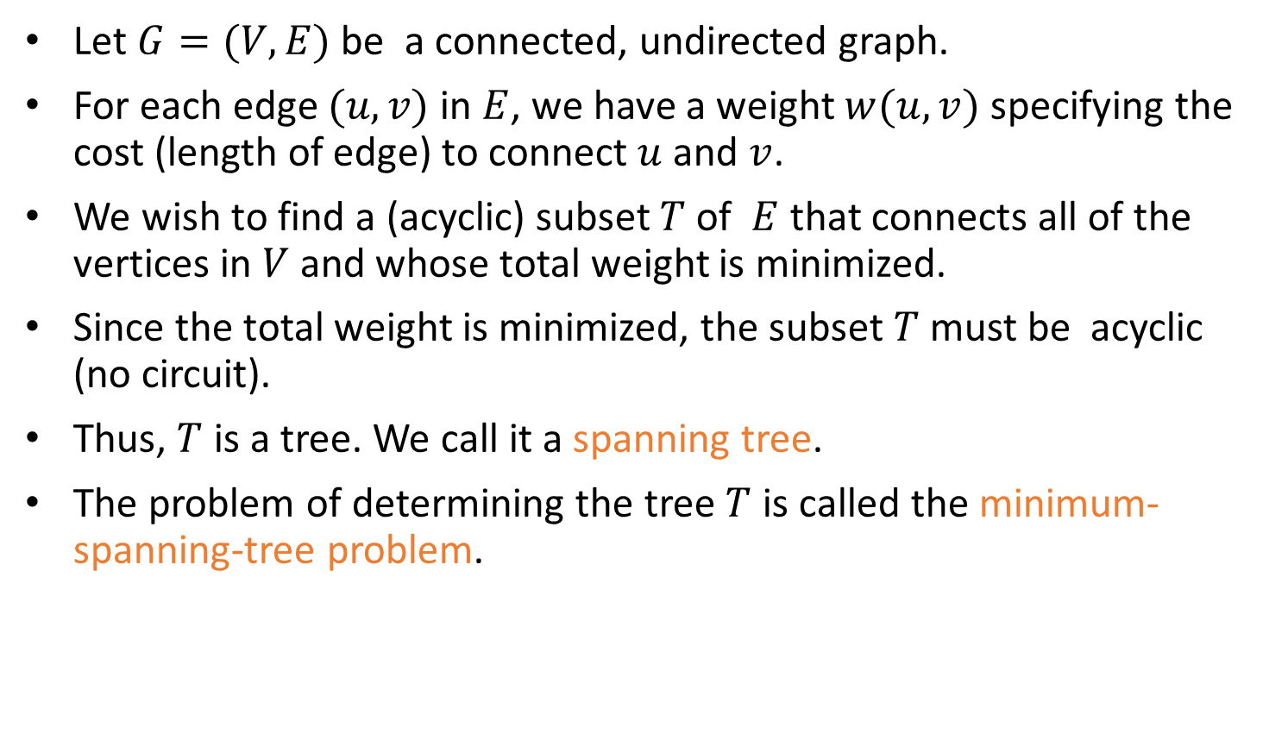
Definition of MST
Let $G=(V,E)$ be a connected, undirected graph.
For each edge $(u,v)$ in $E$, we have a weight $w(u,v)$ specifying the cost (length of edge) to connect $u$ and $v$.
We wish to find a (acyclic) subset $T$ of $E$ that connects all of the vertices in $V$ and whose total weight is minimized.
Since the total weight is minimized, the subset $T$ must be acyclic (no circuit).
Thus, $T$ is a tree. We call it a spanning tree.
The problem of determining the tree $T$ is called the minimum-spanning-tree problem.

Slide 3

Application of MST
In the design of electronic circuitry, it is often necessary to make a set of pins electrically equivalent by wiring them together.
To interconnect n pins, we can use n-1 wires, each connecting two pins.
We want to minimize the total length of the wires.
Minimum Spanning Trees can be used to model this problem.

Slide 4
Application of MST
Problem: Laying Telephone Wire
Central office

Slide 5
Application of MST
Wiring: Naïve Approach
Central office
Expensive!

Slide 6
Application of MST
Wiring: Better Approach
Central office
Minimize the total length of wire connecting the customers

Slide 7
Here is an example of a connected graph and its minimum spanning tree:
8
7
b
c
d
9
4
2
a
11
i
14
e
4
7
6
8
10
h
g
f
1
2
Notice that the tree is not unique:
replacing (b,c) with (a,h) yields another spanning tree with the same minimum weight.

Slide 8
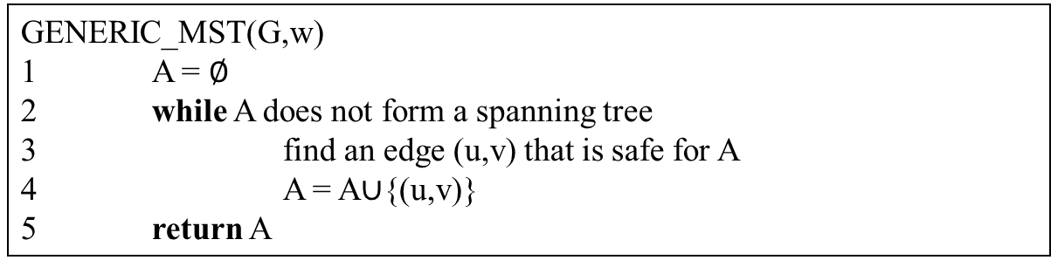

Growing a MST(Generic Algorithm)
Set $A$ is always a subset of some minimum spanning tree. This property is called the invariant Property.
An edge $(u,v)$ is a safe edge for $A$ if adding the edge to $A$ does not destroy the invariant.
A safe edge is just the CORRECT edge to choose to add to T.
GENERIC_MST(G,w)
1 A = $∅$
2 while A does not form a spanning tree
3 find an edge (u,v) that is safe for A
4 A = A∪{(u,v)}
5 return A

Slide 9
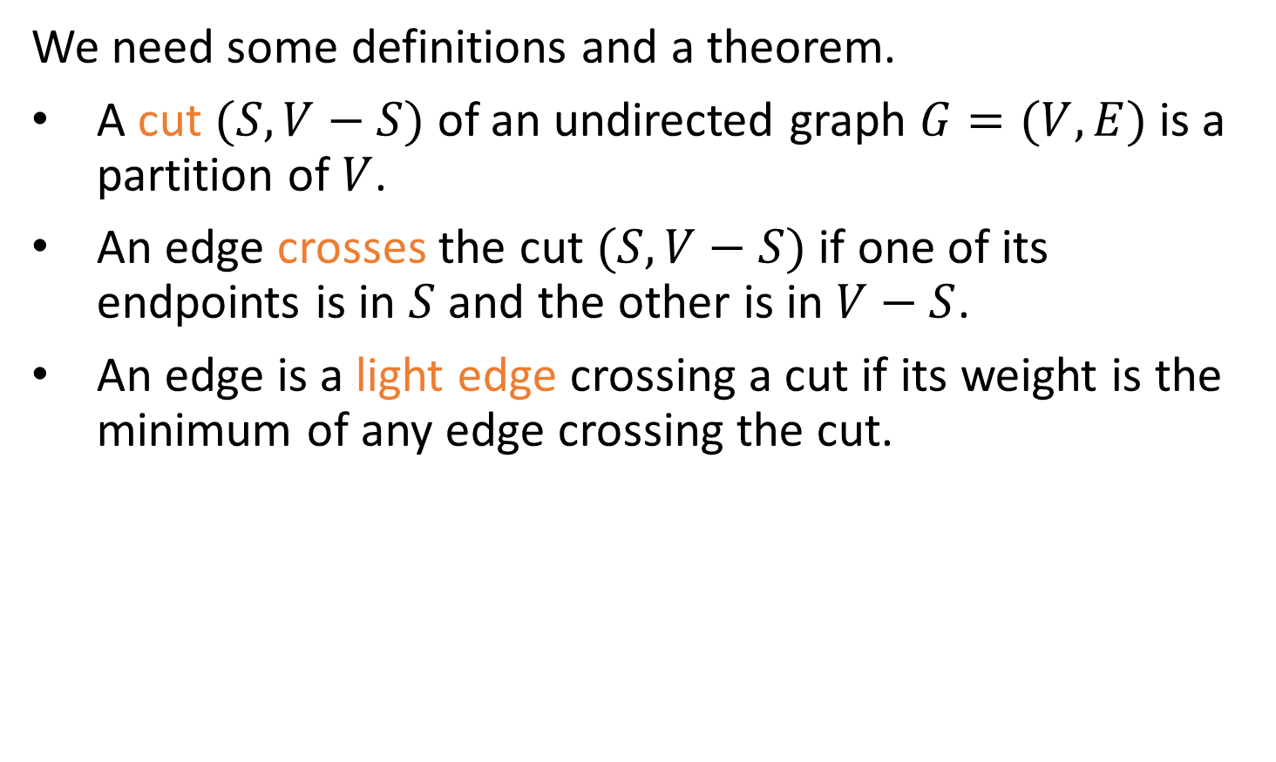
How to Find a Safe Edge
We need some definitions and a theorem.
A cut $(S,V−S)$ of an undirected graph $G=(V,E)$is a partition of $V$.
An edge crosses the cut $(S,V−S)$ if one of its endpoints is in $S$ and the other is in $V−S$.
An edge is a light edge crossing a cut if its weight is the minimum of any edge crossing the cut.

Slide 10
How to Find a Safe Edge
8
7
b
c
d
9
4
2
S↑
a
11
i
14
e
↑ S
4
7
6
8
10
V-S↓
h
g
f
↓ V-S
1
2
This figure shows a cut (S,V-S) of the graph.
The edge (d,c) is the unique light edge crossing the cut.

Slide 11
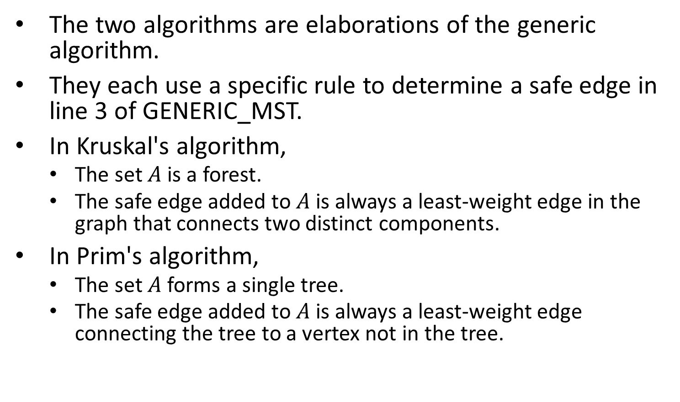
The Algorithms of Kruskal and Prim
The two algorithms are elaborations of the generic algorithm.
They each use a specific rule to determine a safe edge in line 3 of GENERIC_MST.
In Kruskal's algorithm,
The set $A$ is a forest.
The safe edge added to $A$ is always a least-weight edge in the graph that connects two distinct components.
In Prim's algorithm,
The set $A$ forms a single tree.
The safe edge added to $A$ is always a least-weight edge connecting the tree to a vertex not in the tree.

Slide 12
Related Topics
Disjoint-Set (Chapter 21, Page 571)
Keep a collection of disjoint sets: S₁, S₂, .., S_{k},
Each S_{i} is a set, e,g, S₁={v₁, v₂, v₈}.
Three operations
Make-Set(x) - creates a new set whose only member is x.
Union(x, y) – unites the sets that contain x and y, say, S_{x} and S_{y}, into a new set that is the union of the two sets.
Find-Set(x) - returns a pointer to the representative of the set containing x.

Slide 13
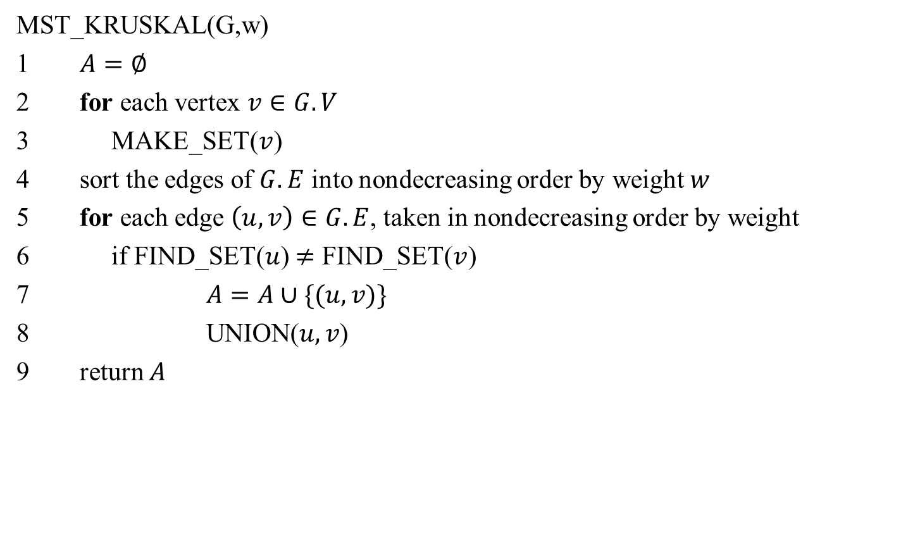
Kruskal's Algorithm
MST_KRUSKAL(G,w)
1 $A=∅$
2 for each vertex $v∈G.V$
3 MAKE_SET($v$)
4 sort the edges of $G.E$ into nondecreasing order by weight $w$
5 for each edge $\left(u,v\right)∈G.E$, taken in nondecreasing order by weight
6 if FIND_SET($u$) $≠$ FIND_SET($v$)
7 $A=A∪\{(u,v)\}$
8 UNION($u,v$)
return $A$

Slide 14
Time Complexity of Kruskal's Algorithm
Line 4 sorts E edges => it takes O(E lgE) time, if we use MergeSort
But lg E = O(lg V), since E < V² => lg E < 2 lg V => E is O(lg V)
Hence O(E lg E) = O(E lg V)
If we make total m calls of Make_set, Union, and Find_set in any algorithm, then these calls will take total O(m lg n) time, where n is the number of Make-Set calls.
The 1st for loop makes O(V) MAKE_SET() calls and the 2nd for loop makes O(E) Find_SET and UNION calls
Total O(V+E) calls of MAKE_SET, FIND_SET, and UNION, out of which O(V) calls were MAKE_SET calls => O((V+E) lgV) time
E ≥ V-1, since the graph is connected
=> V is O(E)=> O((V+E) lgV) = O(E lgV)
Hence total time = O(E lg V)

Slide 15
Kruskal's Algorithm: Example
The edges considered by the algorithm are sorted by weight.
The edge under consideration at each step is shown with a red weight number.
8
7
b
c
d
9
4
2
a
11
i
14
e
4
7
6
8
10
h
g
f
1
2

Slide 16
Kruskal's Algorithm: Example
The edges are considered by the algorithm in sorted order by weight.
The edge under consideration at each step is shown with a red weight number.
8
7
b
c
d
9
4
2
a
11
i
14
e
4
7
6
8
10
h
g
f
1
2

Slide 17
Kruskal's Algorithm: Example
The edges are considered by the algorithm in sorted order by weight.
The edge under consideration at each step is shown with a red weight number.
8
7
b
c
d
9
4
2
a
11
i
14
e
4
7
6
8
10
h
g
f
1
2

Slide 18
Kruskal's Algorithm: Example
The edges are considered by the algorithm in sorted order by weight.
The edge under consideration at each step is shown with a red weight number.
8
7
b
c
d
9
4
2
a
11
i
14
e
4
7
6
8
10
h
g
f
1
2

Slide 19
Kruskal's Algorithm: Example
The edges are considered by the algorithm in sorted order by weight.
The edge under consideration at each step is shown with a red weight number.
8
7
b
c
d
9
4
2
a
11
i
14
e
4
7
6
8
10
h
g
f
1
2

Slide 20
Kruskal's Algorithm: Example
The edges are considered by the algorithm in sorted order by weight.
The edge under consideration at each step is shown with a red weight number.
8
7
b
c
d
9
4
2
a
11
i
14
e
4
7
6
8
10
h
g
f
1
2

Slide 21
Kruskal's Algorithm: Example
The edges are considered by the algorithm in sorted order by weight.
The edge under consideration at each step is shown with a red weight number.
8
7
b
c
d
9
4
2
a
11
i
14
e
4
7
6
8
10
h
g
f
1
2

Slide 22
Kruskal's Algorithm: Example
The edges are considered by the algorithm in sorted order by weight.
The edge under consideration at each step is shown with a red weight number.
8
7
b
c
d
9
4
2
a
11
i
14
e
4
7
6
8
10
h
g
f
1
2

Slide 23
Kruskal's Algorithm: Example
The edges are considered by the algorithm in sorted order by weight.
The edge under consideration at each step is shown with a red weight number.
8
7
b
c
d
9
4
2
a
11
i
14
e
4
7
6
8
10
h
g
f
1
2

Slide 24
Kruskal's Algorithm: Example
The edges are considered by the algorithm in sorted order by weight.
The edge under consideration at each step is shown with a red weight number.
8
7
b
c
d
9
4
2
a
11
i
14
e
4
7
6
8
10
h
g
f
1
2

Slide 25
Kruskal's Algorithm: Example
The edges are considered by the algorithm in sorted order by weight.
The edge under consideration at each step is shown with a red weight number.
8
7
b
c
d
9
4
2
a
11
i
14
e
4
7
6
8
10
h
g
f
1
2

Slide 26
Kruskal's Algorithm: Example
The edges are considered by the algorithm in sorted order by weight.
The edge under consideration at each step is shown with a red weight number.
8
7
b
c
d
9
4
2
a
11
i
14
e
4
7
6
8
10
h
g
f
1
2

Slide 27

Prim's Algorithm
MST_PRIM(G,w,r)
1 for each $u$ in $G.V$
$u.key=∞$
$u.π=$NIL
4 $r.key=0$
5 $Q=G.V$ //Q is a min-priority queue
6 while $Q≠∅$
7 $u=$EXTRACT_MIN($Q$)
8 for each $v∈G.Adj[u]$
9 if $v∈Q$ and $w\left(u,v\right)<v.key$
10 $v.π=u$
11 $v.key=w(u,v)$

Slide 28
Prim's Algorithm
Grow the minimum spanning tree from the root vertex r.
Q is a priority queue, holding all vertices that are not in the tree now.
key[v] is the minimum weight of any edge connecting v to a vertex in the tree.
parent[v] names the parent of v in the tree.
When the algorithm terminates, Q is empty; the minimum spanning tree A for G is thus A={(v,parent[v]):v∈V-{r}}.
Running time: O(Elg V).

Slide 29
Running time of Prim's Algorithm
// O(V)
//Θ(V) time to build the heap
//V Heap-Extract-Min operations: O(V lg V)
//E Heap-Decrease-Key operations: O(E lg V)
Total time = O((V+E) lg V) = O(E lg V) since E ≥ V-1 => V is O(E)

Slide 30
Prim’s algorithm using Fibonacci Heaps
It is possible to do better via Fibonacci Heap, which is a priority queue implementation that can do
EXTRACT-MIN in Θ(lgV)
DECREASE-KEY in Θ(1) amortized time.
amortized running time is the time taken by an operation in average irrespective of the probability distribution of the inputs. In contrast, computation of expected/average running time requires one to assume a certain input distribution. (See CLRS, Chapter 20 for details).
Using Fibonacci Heap improves the time from Θ(ElgV) to Θ(VlgV+E). (We had Θ(VlgV+ElgV), but the second lgV becomes 1.)
This is better for dense graphs (E ≈ V²).
Theoretical interest only —Fibonacci heaps have a large constant.

Slide 31
Prim's Algorithm: Example
NIL,∞
8
NIL,∞
NIL,∞
the root vertex
c
7
d
b
9
4
NIL,∞
2
NIL,0
a
11
i
4
14
e
NIL,∞
7
6
8
10
h
g
f
NIL,∞
1
NIL,∞
2
NIL,∞

Slide 32
Prim's Algorithm: Example
a,4
8
NIL,∞
NIL,∞
c
7
d
b
9
4
NIL,∞
2
NIL,0
a
11
i
4
14
e
NIL,∞
7
6
8
10
h
g
f
a,8
1
NIL,∞
2
NIL,∞

Slide 33
Prim's Algorithm: Example
a,4
8
b,8
7
NIL,∞
b
c
d
9
4
NIL,∞
2
NIL,0
a
11
i
14
e
NIL,∞
4
7
6
8
10
h
g
f
a,8
1
NIL,∞
2
NIL,∞

Slide 34
Prim's Algorithm: Example
a,4
8
b,8
7
c,7
b
c
d
9
4
c,2
2
NIL,0
a
11
i
14
e
NIL,∞
4
7
6
8
10
h
g
f
a,8
1
NIL,∞
2
c,4

Slide 35
Prim's Algorithm: Example
a,4
8
b,8
7
c,7
b
c
d
9
4
c,2
2
NIL,0
a
11
i
14
e
NIL,∞
4
7
6
8
10
h
g
f
i,7
1
i,6
2
c,4

Slide 36
Prim's Algorithm: Example
a,4
8
b,8
7
c,7
b
c
d
9
4
c,2
2
NIL,0
a
11
i
14
e
f,10
4
7
6
8
10
h
g
f
i,7
1
f,2
2
c,4

Slide 37
Prim's Algorithm: Example
a,4
8
b,8
7
c,7
b
c
d
9
4
c,2
2
NIL,0
a
11
i
14
e
f,10
4
7
6
8
10
h
g
f
g,1
1
f,2
2
c,4

Slide 38
Prim's Algorithm: Example
a,4
8
b,8
7
c,7
b
c
d
9
4
c,2
2
NIL,0
a
11
i
14
e
f,10
4
7
6
8
10
h
g
f
g,1
1
f,2
2
c,4

Slide 39
Prim's Algorithm: Example
a,4
8
b,8
7
c,7
b
c
d
9
4
c,2
2
NIL,0
a
11
i
14
e
d,9
4
7
6
8
10
h
g
f
g,1
1
f,2
2
c,4

Slide 40
Prim's Algorithm: Example
a,4
8
b,8
7
c,7
b
c
d
9
4
c,2
2
NIL,0
a
11
i
14
e
d,9
4
7
6
8
10
h
g
f
g,1
1
f,2
2
c,4

